Slide 1
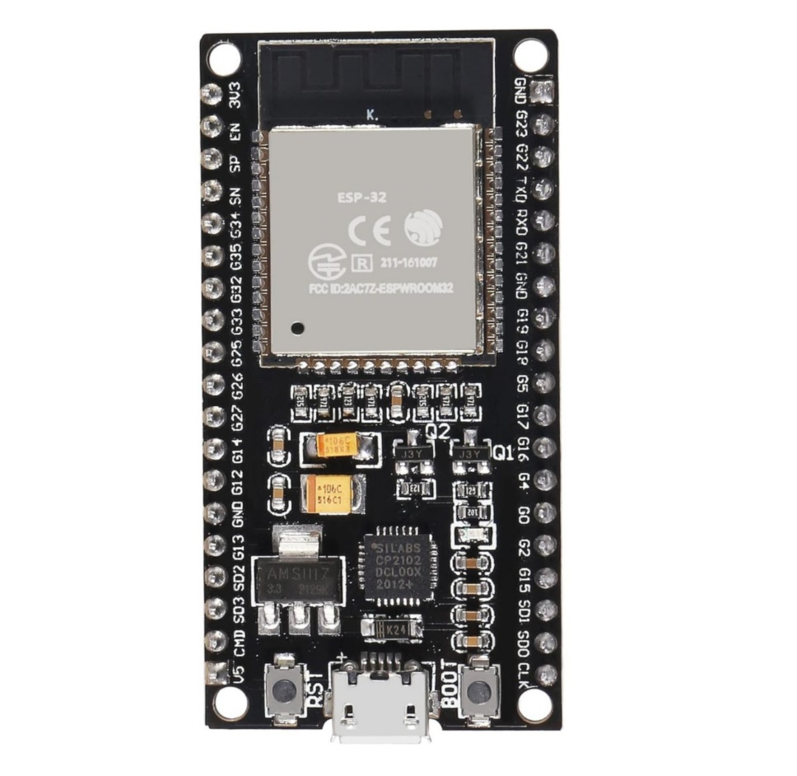


Slide 2


NODE #01
SERVER NODE
NODE #02
NODE #03
.
.
.
.
NODE #N

Slide 3
START
MULTIHOPPING ALGORITHM
Setup: Serial, DHT, WiFi STA, ESP-NOW, Callbacks, Tasks
helloTask (every 5s)
Broadcast HELLO packet
Remove stale neighbors
Update neighbor table (MAC, RSSI, hop+1)
SensorTask (every 10s)
Read DHT & MQ sensorsIf transmission enabled → queue packet

Slide 4
txTask
Check queue → dequeue packet
Select best next hop
(lowest hop, tie → highest RSSI)
Send data packet
OnDataRecv
If HELLO → update neighbor table
If DATA →
If destination = me/server → print data
Else → increment hopCount, queue for forwarding

Slide 5
OnDataSent
Print destination MAC and status (OK / FAIL)
END

